Slide 1


Comparative review of the professional standards in Hungary, Romania, Slovakia and the Czech Republic in the field of career development Slovakia
12nd of February 2026 Budapest
Erasmus+
(Project No: 2024-1-SK01-KA210-VET-000249838)

Slide 2

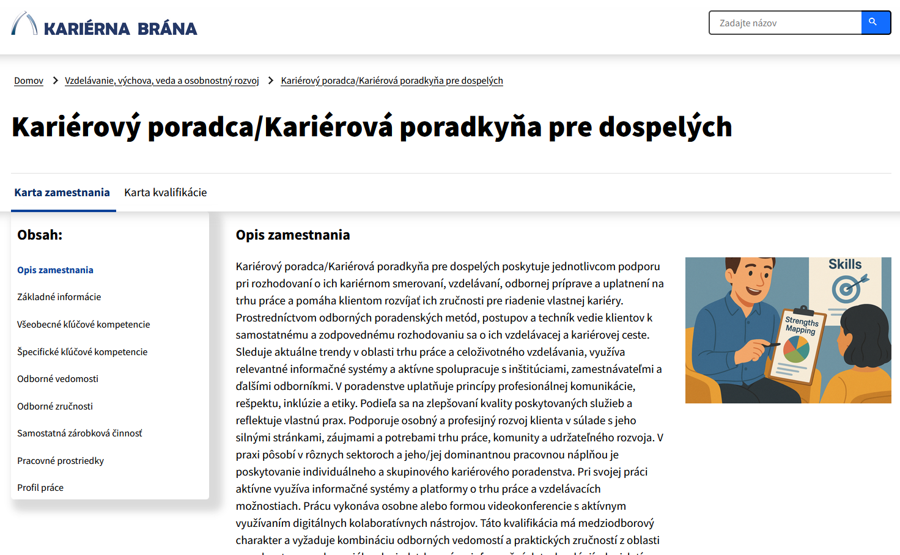
Landscape: The starting points for research in Slovakia
The field is regulated separately by separate laws in the employment sector (2004), school sector (2019) and lifelong learning sector (2025). Despite efforts, there is no unified competence framework/standard for career practitioners
There were several attempts to formalize competences of career practitioners
National occupational framework (2015) – trans-sectoral occupational standard inspired by NICE framework (career consultant, career counsellor, career specialist)
Quality standard developed by the professional association (2018)
Career guidance counsellor for lifelong learning, competence standard for RPL (2025) – used in the analysis

Slide 3
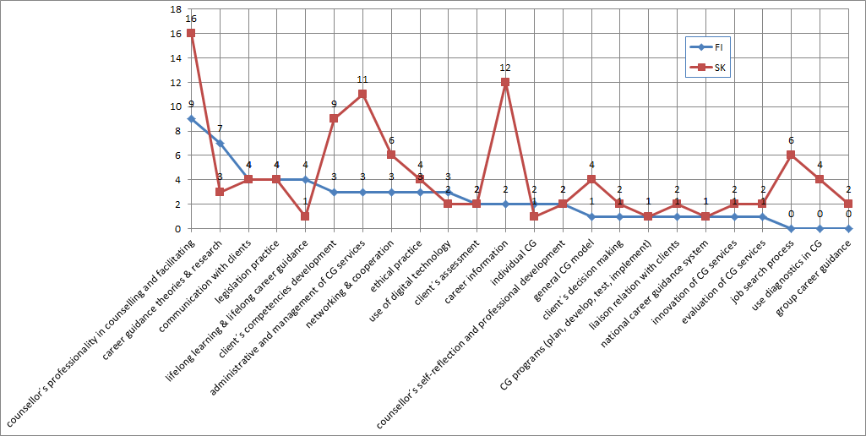
Slovak v. Finnish document
Counsellor’s professionality in counselling and facilitation
Career information
Administrative and management of CG services
Client’s competencies development

Slide 4
Tab No. 5: Implications from the comparison Finnish v. Slovak document
Dimension | Finland (FI) | Slovakia (SK)
Orientation | Balanced, theory-informed, and ethically grounded | Practice-based and operational; service-oriented
Core strengths | Ethics, theory integration, digital competence, and evaluative culture | Professional counselling skills, career information, client competence development, service administration
Weaker domains | Less focus on specialized diagnostic depth (as it is standardized systemically) | Theory, research, ethics, digital guidance, and systemic evaluation
Professional identity | Defined through national and EU-aligned standards emphasizing reflection and accountability | Focused on effective service delivery; limited emphasis on autonomy and reflectivity
Model type | Reflective–systemic | Practical–operational

Slide 5
Different visions
Section A – Professionalism
Ethics & professional identity (A1, A3)
FI: Ethics and reflection are explicit transversal competencies; counsellor expected to exercise professional judgement and autonomy, interpret and apply ethical principles
SK: Ethics embedded in professional behaviour and compliance (focus on confidentiality, data protection, and correct procedures - less emphasis on ethical deliberation); reflection present but implicit and individual
Theory & research (A2)
FI: Strong emphasis on theory integration and research-informed practice
SK: Theory mainly applied as background knowledge for counselling delivery
Digital competence (A5)
FI: Digital guidance integrated into professional role (e-guidance, development of digital services)
SK: Digital tools used operationally (information search, diagnostics), limited focus on digital service development
Professionalism as reflective autonomy (FI) vs as applied competence (SK)

Slide 6
Reflectivity vs. operational thouroughness
Section B – Client work
Guidance as a process (B1)
FI: Guidance framed as a process with outcomes, evaluation, and learning
SK: Guidance framed as a sequence of practical interventions and activities, but also with evaluation of learning outcomes (CMS)
Guidance & learning theories (B2)
FI: Lifelong learning and career development theories explicitly integrated, linked to long-term development across life stages
SK: Strong focus on developing client competences, lifelong learning present but mainly as an individual outcome at a specific moment of time
Methodological competence (B3)
FI: Methods selected, justified, and evaluated through theory
SK: Very strong and detailed methodological repertoire (diagnostics, job search, CMS development), with lower focus on reflectiveness
Conceptual and evaluative framing (FI) work vs operational depth (SK)

Slide 7
Difference in the positioning of practitioners
Section C – Systemic competence
Lifelong guidance (C1)
FI: LLG as organising principle of the entire system - Counsellors are expected to understand and contribute to the coherence of services across the life course
SK: LLG present but mainly as client-level objective - focus on supporting individuals in learning, requalification, job search, and transitions; limited emphasis on counsellors’ responsibility for the overall guidance system
Systems & networks (C2, C3)
FI: Counsellor positioned as actor within multi-professional and multi-sector systems. Cooperation is strategic: aligning services, roles, and responsibilities; counsellors are positioned as system actors, not only service providers
SK: Cooperation and networking required, but primarily at operational and institutional level (referrals, coordination, information exchange). Less emphasis on shaping or improving system-level cooperation
Strategic competence (C4)
FI: Strong emphasis on planning, quality assurance, and continuous system development
SK: Administrative and service management skills present, evaluation focuses mainly on service delivery and client outcomes, not system learning
Counsellors as system co-developers vs service providers within systems

