Slide 1



Comparative review of the professional standards of career guidance counsellors: the Czech Republic
12th February 2026
Budapest
Erasmus+ Project No: 2024-1-SK01-KA210-VET-000249838
Zuzana Freibergová
Association of career guidance and career development

Slide 2
Background: Career guidance professional standards – case of the Czech Republic
Ministry of Education, Youth and Sports
School law
HE advisor / Students
Sector
Law regulation
Defined qualification & standard activities
Competence standard
Position / Target group
HE law
Not defined
Law on further education recognition
National qualification framework
FE advisor / Adults
Educational counsellors / Pupils
Qualification standard (75-004-R):
Career guidance counsellor
Ministry of Labour and Social Affairs
Employment law
National occupation framework
LO Career advisors / Adults + students

Slide 3
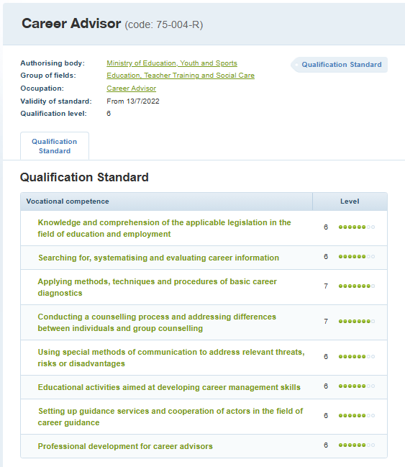


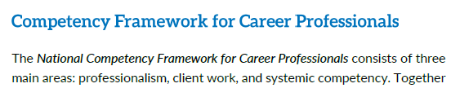
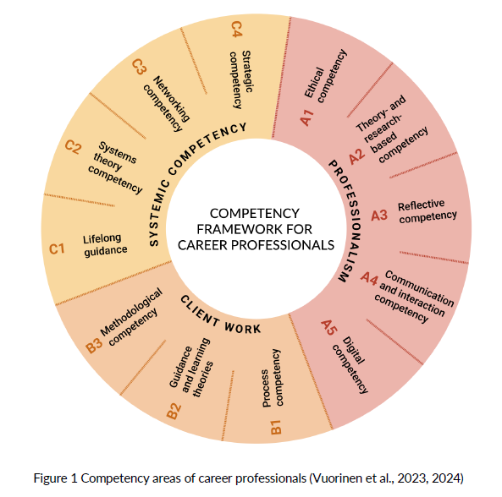
exam syllabus
self evaluation tool

Slide 4
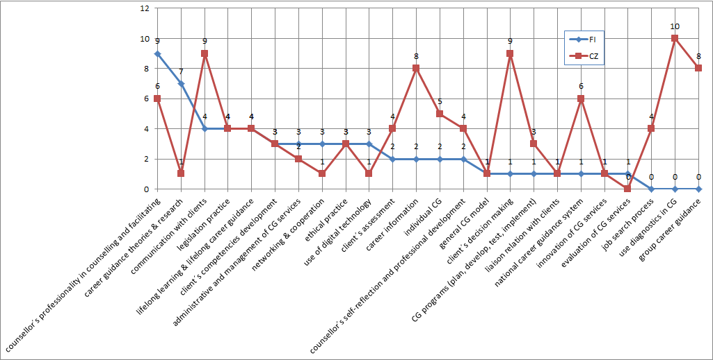
Occurrence of coded text segments in thematic groups CZ v. FI

Slide 5
Differences in concept (1)
Section A – Professionalism
 | Finnish | Czech
Ethical competency (A1) | Is a cornerstone of counsellors professional identity and autonomy. | Ensures service correct provision and client protection.
Theory and research based competency (A2) | Contributes to cultivate professionalism. Uses theories to interpret practice. | Concerns with definitions of terms. Uses theories to standardise knowledge for assessment
Reflective competency (A3) | Considers reflection as a habit of mind and tool of professional evolution | Concentrates on self-quality control and justify guidance process.
Communication and interaction competency (A4) | Is taken as an ethical and relational process | Is a significant counselling element. To communication competencies with different kind of clients is given great emphasis.
Digital competency (A5) | Is integral part of counsellors professional identity | Is missing

Slide 6
Differences in concept (2)
Section B – Client work
 | Finnish | Czech
Guidance as a process (B1) | Encourages counsellors to build their own model of “good and reflective guidance” | Outlines detailed process and repertoire.
Guidance & learning theories (B2) | Theories are embedded across the framework, they guide interpretation of client behaviour and system dynamics. | Uses theories to standardise knowledge for assessment.
Methodological competency (B3) | Ensures methodological flexibility, allowing practitioners to choose and justify approaches based on context and theory | Provides a wide methodological repertoire diagnostics, portfolios, case analysis, job-search support, group activities, and communication techniques for diverse client groups

Slide 7
Differences in concept (3)
Section C – Systemic competency
 | Finnish | Czech
Lifelong guidance (C1) | It is the social mission of advisors in building and coordinating the ecosystem of education and guidance. | Rests with term explanation for evaluation purposes.
Systems (C2) | Integrates systemic thinking in counsellors understanding of organisational dynamics, multi-level governance, and how guidance interacts with other social systems. | Requires knowledge of the system & environment.
Multi-professional and sectoral networks (C3) | Builds strategic ecosystem of networking and cooperation. | Builds networks for practical cooperation.
Strategic competency (C4) | Gives counsellor position of a strategy maker in quality governance. | Expects the counsellor to contribute to personal and procedural quality

Slide 8
Conclusions: CZ v. FI models
 | Finnish document | Czech document
Model type | Theory driven, systemic, balanced and reflective emphasizing quality, autonomy and ethics. | Practice-oriented, focusing on proper service delivery and stressing methods of direct work with clients.
Core strengths | Ethical standards, theoretical literacy, reflection, evaluation culture, and evidence-based practice. | Communication with clients, support of client's decision-making support, provision of career information, use of diagnostics and clients´ assessment.
Weaker points | Slightly less emphasis on applied client-interaction in job search, use of diagnostics and group guidance. | Limited integration of ethics, theory, reflection, lifelong learning principles, service quality assurance and use of digital tools.

