Slide 1





Comparative review of the professional standards in Hungary, Romania, Slovakia and the Czech Republic in the field of career development: Review of the key findings
12nd of February 2026 Budapest
Erasmus+ (Project No: 2024-1-SK01-KA210-VET- 000249838)

Slide 2
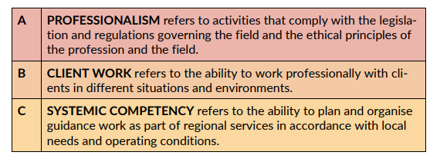

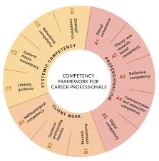
Starting points, methodology
After getting to know the Finnish framework in detail, we decided in the group of experts from the four countries to carry out the mapping exercise for each sub-area of the Finnish framework
(i.e. the area is professionalism and its sub-areas A1 ethical competency, A2 theory and research-based competency and so on). Then we continued with section B (client work) and C (system competencies).
We did not go into details on each sub-area of the original Finnish model because the protocols available from the four countries and the information extracted from the legislations did not allow for such a non-detailed breakdown
English version of the Finnish National Competency Framework for Career Professionals: Assessment forms plus four selected documents from CEEGAF partner countries (CZ, HU, RO, SK) were translated into English and the parts of the text of all five documents that describe the competences were analysed
We run two evaluation cycles:
The first was based on a national professional review
The second was based on Atlas.ti

Slide 3
Analysed documents
No | Country (abbreviation) | Title in English & code | Publisher | Year | No pages | web link
1) | Czech Republic (CZ) | Career Advisor (code: 75-004-R) | National qualification framework (NSK) | 2022 | 11 | https://www.narodnikvalifikace.cz/en-US/qualification-1538
2) | Finland (FI) | National Competency Framework for Career Professionals : Assessment Forms | Finnish Institute for Educational Research Reports and Working Papers | 2024 | 24 | https://jyx.jyu.fi/jyx/Record/jyx_123456789_93089
3) | Hungary (HU) | Professional service protocol for further education and career guidance | Educatio Társadalmi Szolgáltató Nonprofit Kft., Budapest | 2015 | 99 | https://www.oktatas.hu/pub_bin/dload/kozoktatas/pedagogiai_szakszolgalat/tovabbtanulasi-palyavalasztasi-tanacsadas-szakszolgalati-protokoll.pdf
4) | Romania (RO) | Career guidance counsellor (code: 242306) | Classification of occupations in Romania (COR) | 2025 | 13 | https://www.rubinian.com/cor_6_ocupatia_detalii.php?id=242306
5) | Slovakia (SK) | Career counsellor in adult education | National occupational framework (NSK) | 2025 | 12 | https://www.sustavapovolani.sk
These five sources differ significantly in their conceptual foundations, content, structure, practical application, and intended target groups.
Two of them – one from Romania and one from the Czech Republic – are officially published within the national occupational classification systems.
The Slovak document is in the approval process for publication within the Slovak national occupational classification system
The Hungarian document is a theoretical research document.

Slide 4
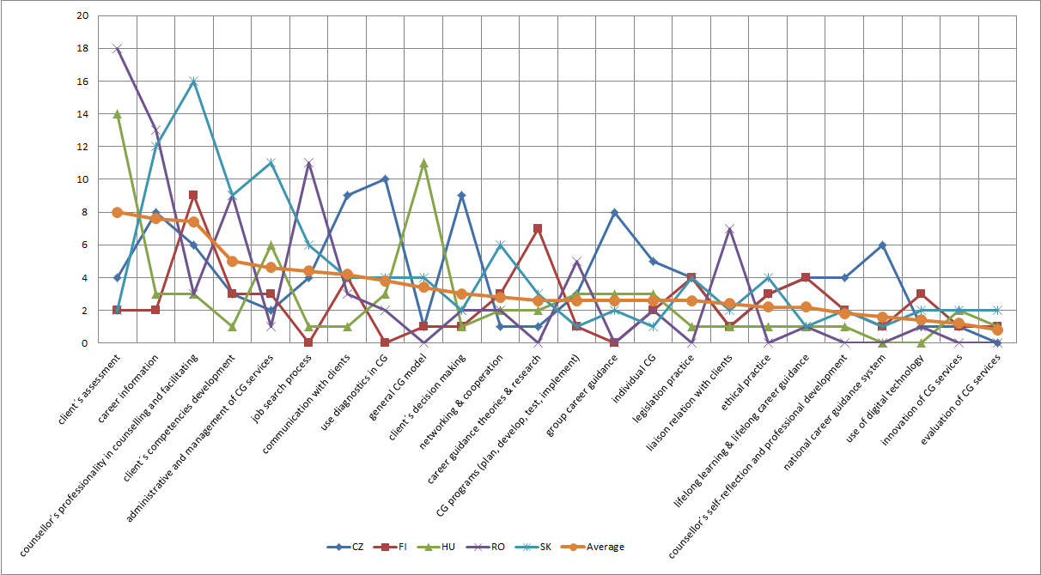
Atlas.ti – software used for qualitative analysis
The next analytical step – categorizing the codes into thematic groups
24 thematic groups of career guidance counsellor competencies and 175 individual codes, which were used to mark 404 quotations - parts of text, sentences or paragraphs.
Each code represents a discrete unit of meaning - in our case a competency of career (guidance) counsellor
Graph No. 1: Number of coded text segment in thematic groups & analysed documents

Slide 5
Thematic code groups (in alphabetical order)
No | Thematic code groups | Number of codes
1 | Competencies related to administrative and management of CG services | 12
2 | Competencies related to career guidance theories & research | 5
3 | Competencies related to career information | 15
4 | Competencies related to CG programs (plan, develop, test, implement) | 4
5 | Competencies related to client´s assessment | 16
6 | Competencies related to client´s competencies development | 12
7 | Competencies related to client´s decision making | 6
8 | Competencies related to communication with clients | 11
9 | Competencies related to counsellor´s professionality in counselling and facilitating | 19
10 | Competencies related to counsellor´s self-reflection and professional development | 4
11 | Competencies related to ethical practice | 3
12 | Competencies related to evaluation of CG services | 3
13 | Competencies related to general CG model | 12
14 | Competencies related to group career guidance | 5
15 | Competencies related to individual CG | 7
16 | Competencies related to innovation of CG services | 5
17 | Competencies related to job search process | 5
18 | Competencies related to legislation practice | 5
19 | Competencies related to liaison relation with clients | 3
20 | Competencies related to lifelong learning & lifelong career guidance | 5
21 | Competencies related to national career guidance system | 3
22 | Competencies related to networking & cooperation | 3
23 | Competencies related to use diagnostics in CG | 9
24 | Competencies related to use of digital technology | 3
 | Total number of codes | 175

Slide 6
Tab No. 3: Number of text segments encoded with one of the 175 codes
No | Thematic code group (in alphabetical order) Competencies related to: | Number of quotation |  |  |  |  | Sum
 |  | CZ | FI | HU | RO | SK
1 | administrative and management of CG services | 2 | 3 | 6 | 1 | 11 | 23
2 | career guidance theories & research | 1 | 7 | 2 | 0 | 3 | 13
3 | career information | 8 | 2 | 3 | 13 | 12 | 38
4 | CG programs (plan, develop, test, implement) | 3 | 1 | 3 | 5 | 1 | 13
5 | client´s assessment | 4 | 2 | 14 | 18 | 2 | 40
6 | client´s competencies development | 3 | 3 | 1 | 9 | 9 | 25
7 | client´s decision making | 9 | 1 | 1 | 2 | 2 | 15
8 | communication with clients | 9 | 4 | 1 | 3 | 4 | 21
9 | counsellor´s professionality in counselling and facilitating | 6 | 9 | 3 | 3 | 16 | 37
10 | counsellor´s self-reflection and professional development | 4 | 2 | 1 | 0 | 2 | 9
11 | ethical practice | 3 | 3 | 1 | 0 | 4 | 11
12 | evaluation of CG services | 0 | 1 | 1 | 0 | 2 | 4
13 | general CG model | 1 | 1 | 11 | 0 | 4 | 17
14 | group career guidance | 8 | 0 | 3 | 0 | 2 | 13
15 | individual CG | 5 | 2 | 3 | 2 | 1 | 13
16 | innovation of CG services | 1 | 1 | 2 | 0 | 2 | 6
17 | job search process | 4 | 0 | 1 | 11 | 6 | 22
18 | legislation practice | 4 | 4 | 1 | 0 | 4 | 13
19 | liaison relation with clients | 1 | 1 | 1 | 7 | 2 | 12
20 | lifelong learning & lifelong career guidance | 4 | 4 | 1 | 1 | 1 | 11
21 | national career guidance system | 6 | 1 | 0 | 0 | 1 | 8
22 | networking & cooperation | 1 | 3 | 2 | 2 | 6 | 14
23 | use diagnostics in CG | 10 | 0 | 3 | 2 | 4 | 19
24 | use of digital technology | 1 | 3 | 0 | 1 | 2 | 7
 | Sum | 98 | 58 | 65 | 80 | 103 | 404

Slide 7
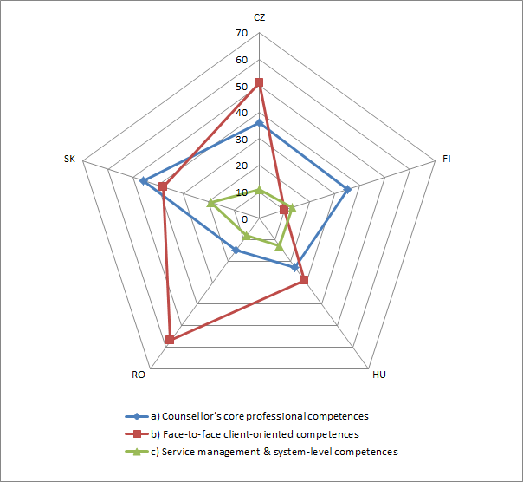
A detalied example
Graph No. 3: Number of coded text segments in clusters
(Czech document is quite balanced in number of codes with substantial presence in two clusters (face-to-face client-oriented competences and counsellor’s core professional competences)

Slide 8
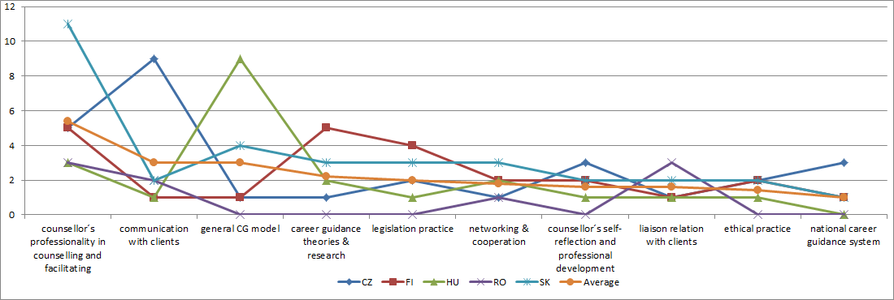
Graph No. 4: Cluster “Counsellor’s core professional competences” – number of codes occurrence in 10 thematic groups

Slide 9
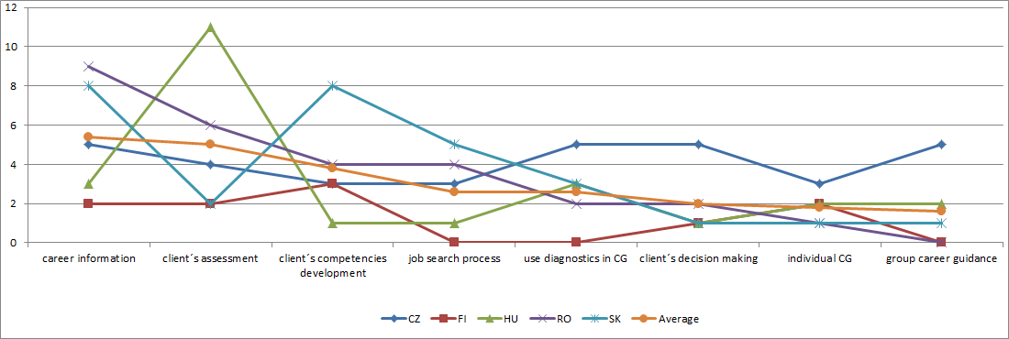
Graph No. 6: Cluster “Face-to-face client-oriented competences” – number of codes occurrence in 8 thematic groups

Slide 10
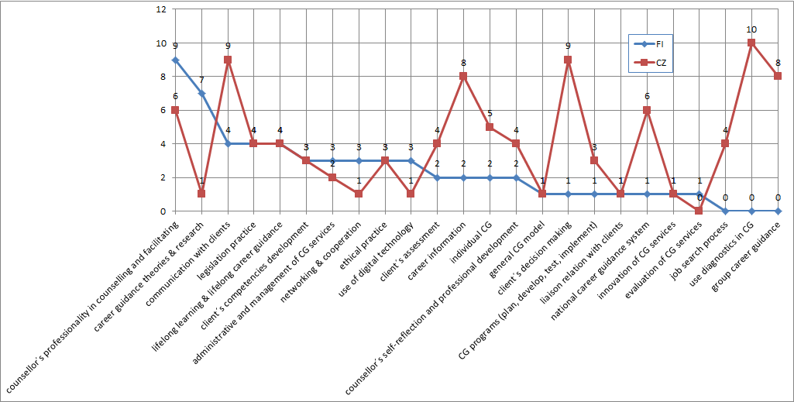
Comparative analysis of national documents / example Czech v. Finnish document: Graph No. 10: Occurrence of coded text segments in thematic groups in the Czech document

Slide 11
First findings
The four Central and Eastern European (CEE) frameworks show greater variability, reflecting different stages of professional system development and national policy priorities.
The Hungarian document is the most different in its character and form of elaboration. While the Czech, Slovak, Romanian documents have the character of an assessment standard of career guidance competences used in the format of recognition of non-formal and informal learning, the Hungarian one is more of a theoretical work on what competences a career guidance counsellor should have.
The Romanian framework reflects fragmented professionalization, where guidance activities are present but insufficiently systematised. Its strong focus on information and diagnostic services suggests an orientation towards service provision without full institutional anchoring.
The Romanian document “Career guidance counsellor (code: 242306)” has the form of the national occupational standard
The Slovak model reflects an action-oriented and practice-oriented approach, where counsellors are not only counsellors but also service creators and institutional actors. However, it places relatively less emphasis on the theoretical foundations and mechanisms for assessing the quality of guidance services, which are key to the Finnish model.
The Czech document shows a well-developed professional and diagnostic orientation … but places more emphasis on practical service provision and interaction between the counsellor and the client.
The Czech document “Career Advisor (code: 75-004-R)” includes a qualification standard, assessment standard and the list of authorized persons or organizations, that can conduct the examination according to the qualification standard

Slide 12
Country cases by one sentence
These countries mostly take a fragmented approaches to the professionalization of career guidance, and professional associations in this field do not have a strong voice in influencing national policies (Freibergová, & Hloušková, 2025)
Comprehensive national models (Slovak and Czech documents)
Conceptual-academic orientation (Finnish document)
Procedural or sub-framework (Hungarian and Romanian documents

Slide 13
References
Borbély-Pecze, T. B., Hloušková, L., & Šprlák, T. (2022). Career/lifelong guidance systems and services: Continuous transformations in a transition region: The case of three Central and Eastern European countries. International Journal of Educational and Vocational Guidance, 22(1), 67–91. https://doi.org/10.1007/s10775-021-09473-4
Cedefop (2022). Developing and implementing career guidance policy and practice in the EU. European Centre for the Development of Vocational Training. https://www.cedefop.europa.eu
ELGPN (2015). ELGPN Tools No. 6: Guidelines for Policies and Systems Development for Lifelong Guidance. University of Jyväskylä, Finnish Institute for Educational Research (FIER) Jyväskylä, ISBN 978-951-39-6347-7 (pdf) https://www.elgpn.eu/publications/elgpn-tools-no-6-guidelines-for-policies-and-systems-development-for-lifelong-guidance
IAEVG (2018). International Competencies for Educational and Vocational Guidance Practitioners Url: https://iaevg.com/competencies
Kettunen, J., Vuorinen, R., & Sampson, J. P. (2013). Career practitioners’ conceptions of social media in career services. British Journal of Guidance & Counselling, 41(3), 302–317. https://doi.org/10.1080/03069885.2013.781572
O’Reilly, V., McMahon, M., & Parker, P. (2020). Career development: Profession or not? Australian Journal of Career Development, 29(2), 79-86. https://doi.org/10.1177/1038416219898548
NICE (2012). Handbook for the Academic Training of Career Guidance and Counselling Professionals Edited by Christiane Schiersmann, Bernd-Joachim Ertelt, Johannes Katsarov, Rachel Mulvey, Hazel Reid & Peter Weber Url: https://nice-network.eu/pub/
Vuorinen, R., Kasurinen, H., Kettunen, J., Kukkaneva, E., Ruusuvirta-Uuksulainen, O. (2024). A proposal for a National Competency Framework for Career Professionals. Finnish Institute for Educational Research Reports and Working Papers 6. University of Jyväskylä, Finnish Institute for Educational Research. ISBN:978-951-39-9817-2
Kettunen, J., Vuorinen, R., Kasurinen, H., Kukkaneva, E. & Ruusuvirta-Uuksulainen, O. (2024b). National Competency Framework for Career Professionals: Assessment Forms. Finnish Institute for Educational Research Reports and Working Papers.9. University of Jyväskylä, Finnish Institute for Educational Research. ISBN:978-951-39-9928-5
FREIBERGOVÁ, Z., HLOUŠKOVÁ. L. (2025). Expected competences of career guidance practitioners in partner countries: Czech Republic, Hungary, Romania, Slovakia, Finland. Research report. Project ERASMUS+ “Central and Eastern European Guidance Association Forum” (CEEGAF). Prague

