Slide 1


ACROM Asociația Consilierilor Români Romanian Career Counsellors Association
Comparative review of the professional standards in Hungary, Romania, Slovakia and the Czech Republic in the field of career development ROMANIA

Slide 2
Career counseling MODELS: The ICC project – Information and Career Counseling ACROM and the GCDF model The CEC model – of the Romanian Association for Counseling and Support Career Guidance Counselors and Vocational Counselors Ministry of Labour – training professional STANDARD; EduCONS Model – Ministry of Education – in implementation stage
FORUM

Slide 3
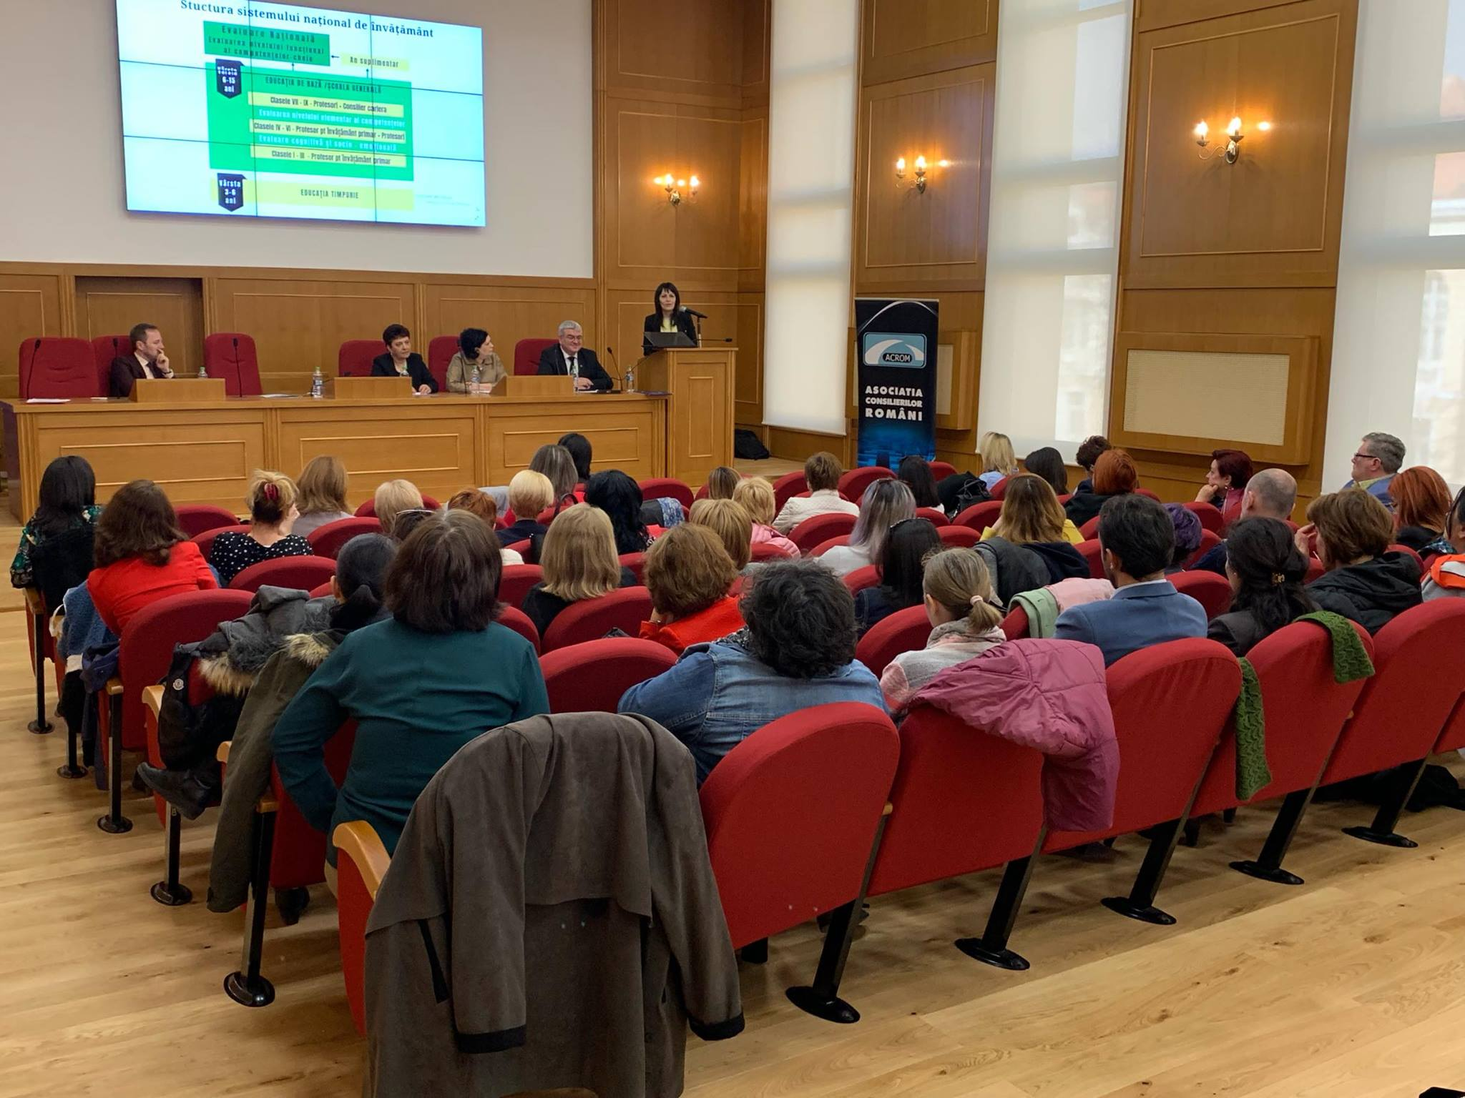
Section A – Professionalism- A1 Ethical competence: Thus, Finland treats ethics explicitly as a visible framework for autonomy and responsibility, while Romanian tacitly integrates ethics into relational skills and customer/beneficiary-cantered attitudes. The Romanian approach is strong in terms of human sensitivity, but offers fewer tools to manage complex ethical conflicts, systemic injustices or border issues. A2 Career Guidance Theory: Finnish framework uses theory as an interpretive and development lens for the entire professional approach in career counseling. Romanian framework uses theoretical notions as context for concrete methods and messages (e.g. "jobs of the future", "student-centred learning") without asking advisors to occupy a researcher-practitioner role.
FORUM

Slide 4
A3 Reflective Competence: Thus, Romanian model prepares counselors to reflect in the service of better decisions for clients, while Finnish framework prepares them to reflect on themselves, their profession and the system. A4 Communication and interaction : Romanian model offers a detailed micropedagogy of communication during the sessions. Finland offers a macro perspective where communication is also advocacy, networking and professional representation.
Both are powerful, but at different levels of abstraction and intervention – the Finnish one relates to the counseling process (intervention), the Romanian one to the training process of career guidance counsellors (or vocational counsellors) – an approach that would later need to be found in their professional activity.
FORUM

Slide 5
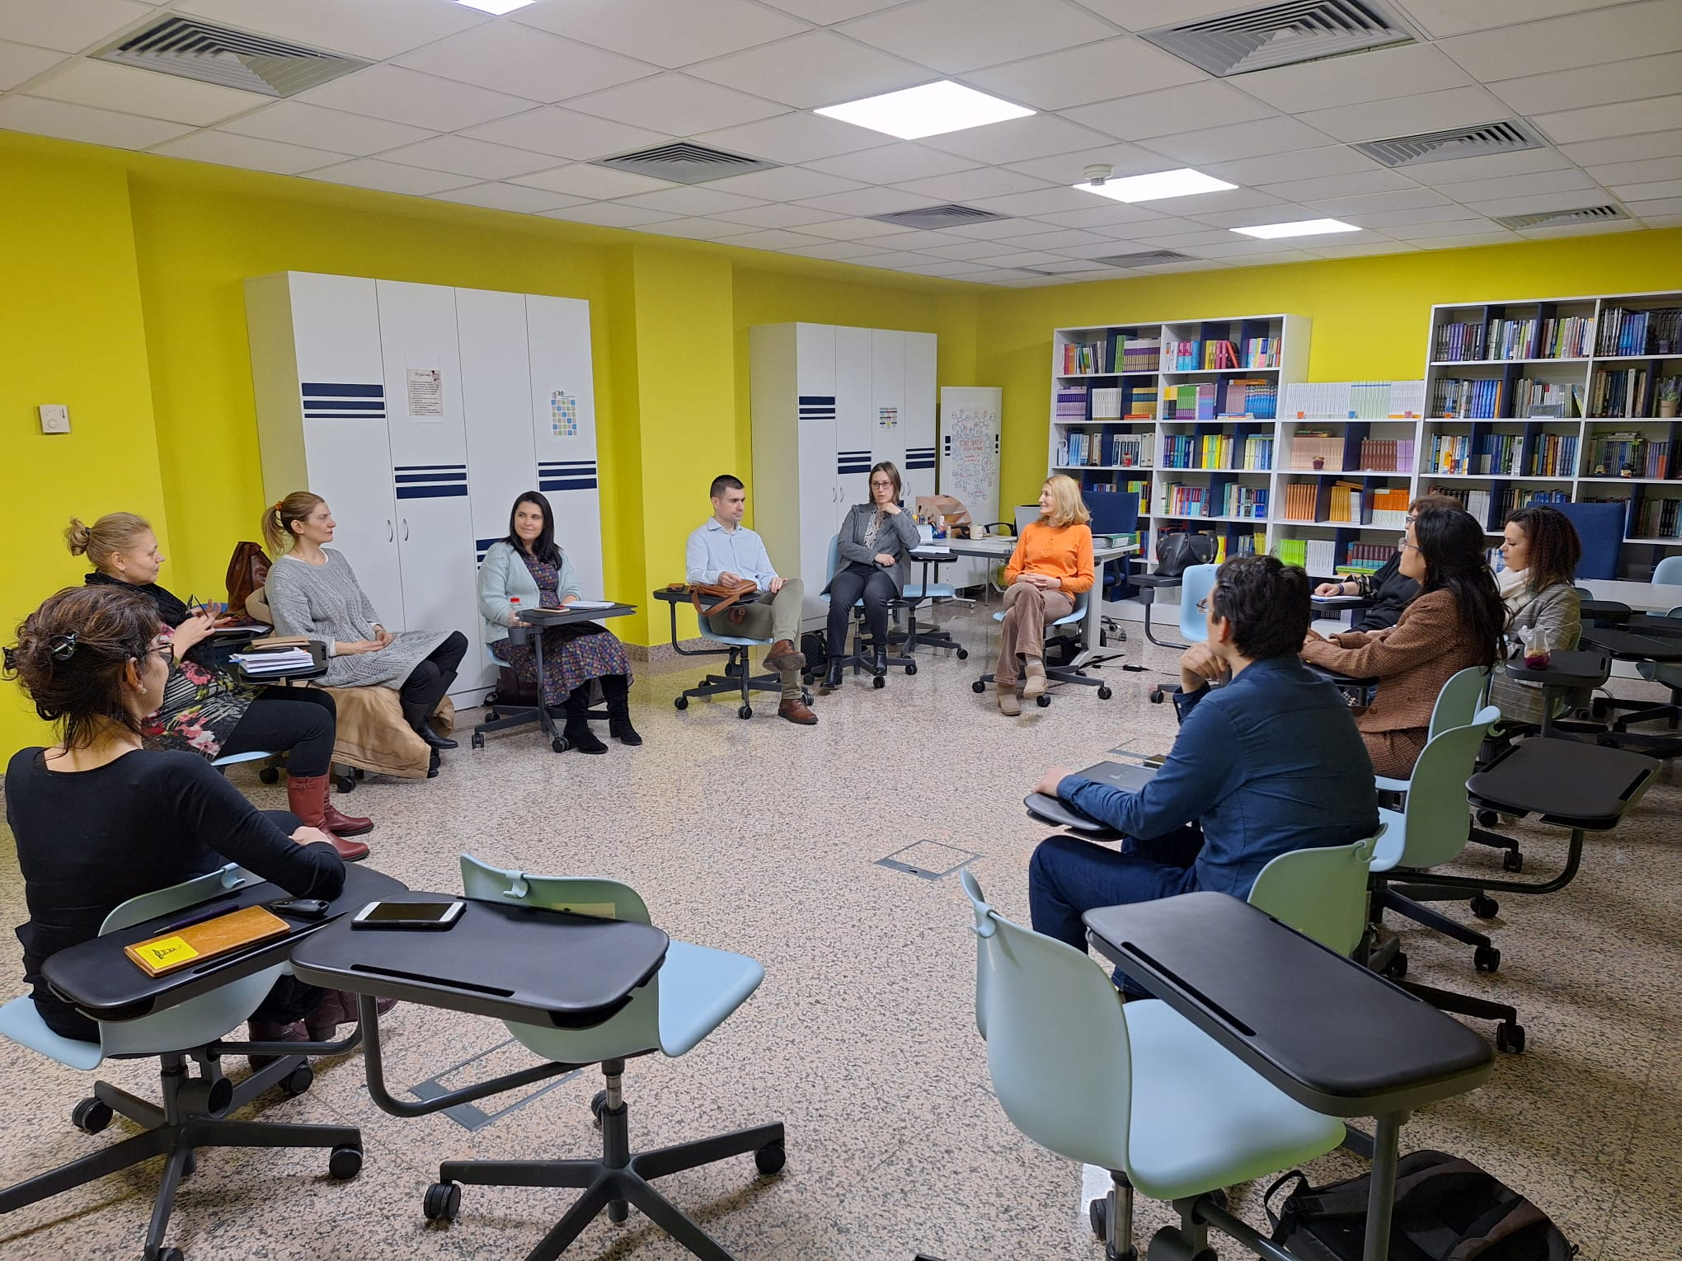
Section B – Working with clients - B1 Guiding as a process: Romanian standard is strong in terms of step-by-step work with clients, and weaker in terms of evaluative and evidence-based thinking about the process. B2 Guidance and theories of learning: The focus is on aligning clients with a changing labour market, not on using formal theories to critically examine guiding goals and practices. B3 Methodological competence: Finnish model provides a meta-methodological framework; Romanian standard offers a detailed methodological curriculum.
FORUM

Slide 6
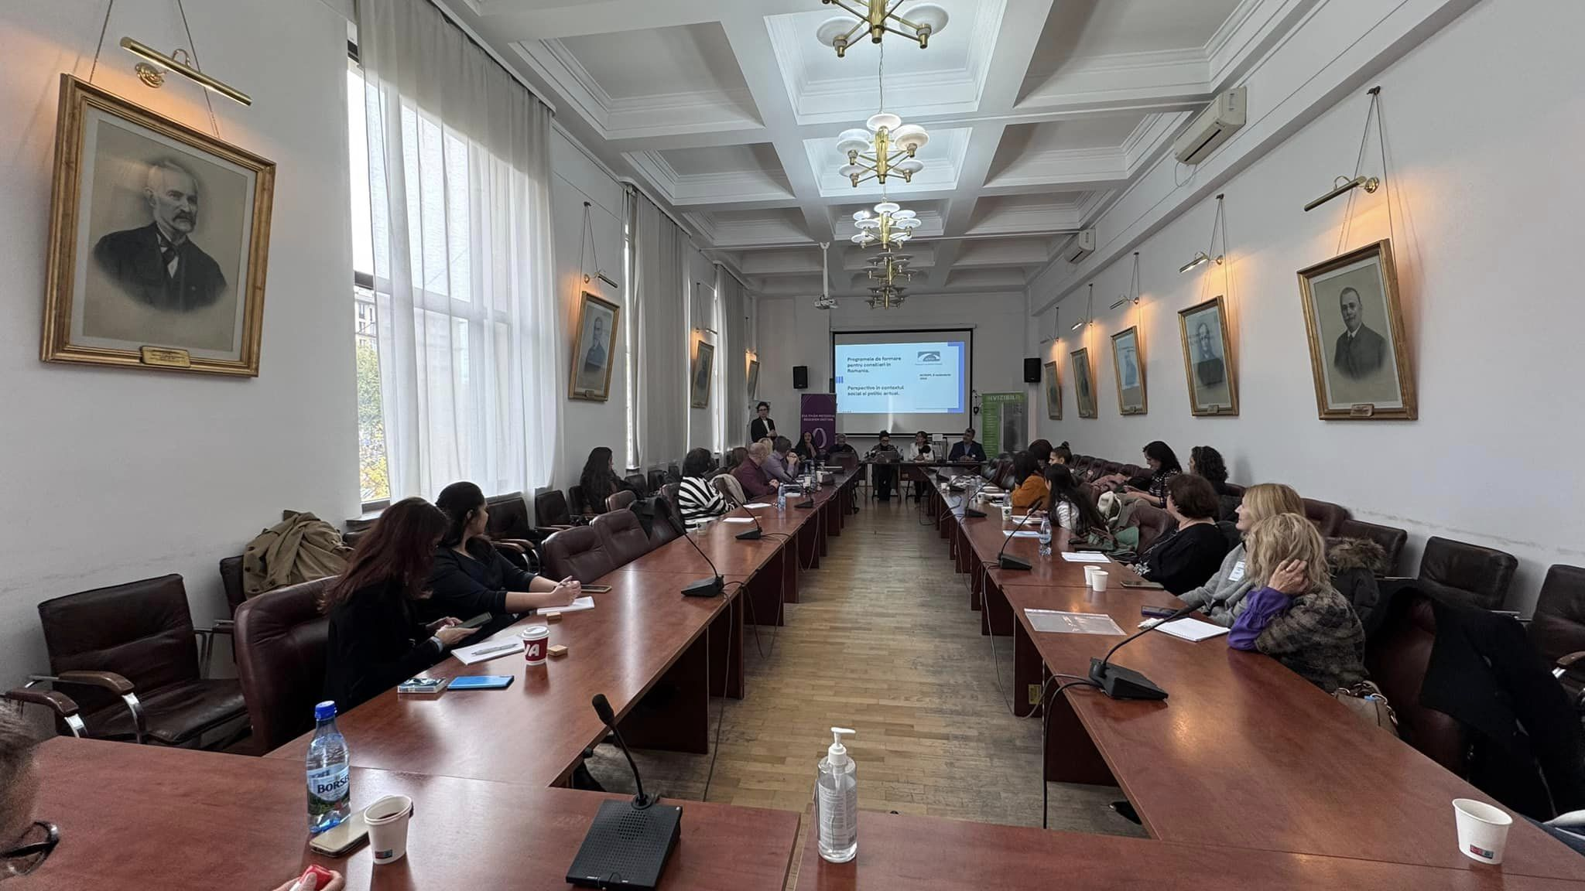
Section C – Systemic competence - C1 Lifelong Guidance (LLG): LLG in Romanian model is client-centric, but not system-centric: the counselor brings the individual to lifelong learning; he does not expect to co-model the national LLG architecture C2 Systems: Romanian model presents a strong signal that professionals are expected to read the system and interact with key actors, but not necessarily to get involved in the development of institutional strategies or multi-level governance. Systemic competence is presented as bottom-up sensitivity and information gathering, rather than top-down design and co-creation;
FORUM

Slide 7
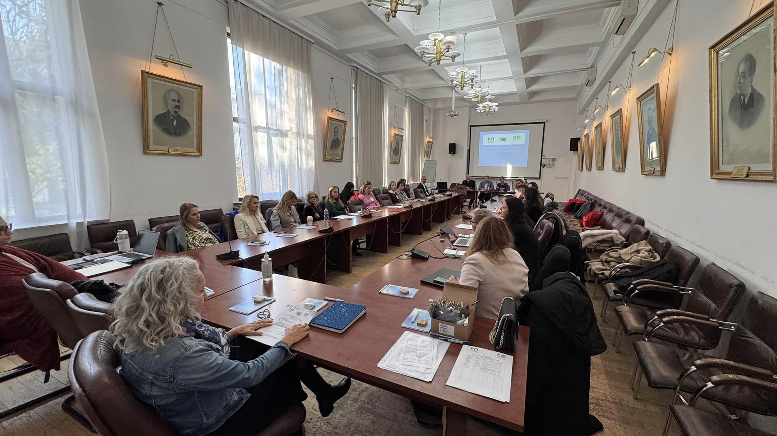
C3 Interbranch and sectoral networks: Romania's career counselors are integrated into local educational and HR networks, which is a strength, but networking is presented as "getting information and support for clients", not as "building a common mentoring ecosystem". C4 Strategic competence: Romanian model cultivates strategic thinking at the micro and meso level (programs, individual trajectories), while Finnish model expands it at the macro level (service systems, quality governance).
FORUM

Slide 8
General summary Finnish model offers a reflective, theory-informed, and systems-oriented meta-framework suitable for professionalization, cross-sectoral LLG policies, and competency-based PCD. Romanian model offers an occupational standard rich in practice, similar to a curriculum, ideal for designing and accrediting training programs and ensuring a solid minimum standard of practice (180 hours; strong emphasis on practice, methods and communication).
Thank you! dr. Vasile DEAC 0040.721203291 vasiledeac@acrom.org.ro vasideac@arcs.ro www.acrom.org.ro
FORUM

